Slide 1
Unit 3
COMBINATIONAL CIRCUITS

Slide 2
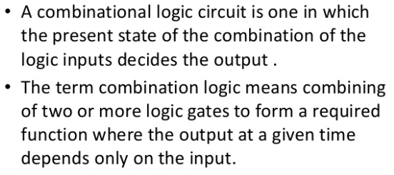
COMBINATIONAL CIRCUITS

Slide 3
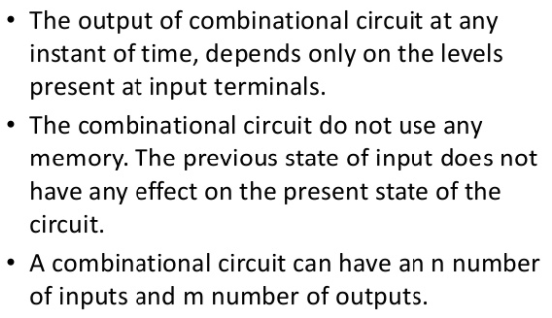
Characteristics

Slide 4
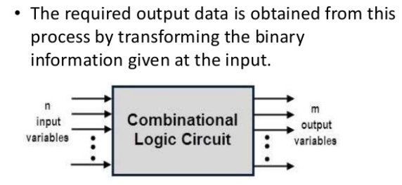
Block Diagram

Slide 5
Classification of Combinational Logic
Adder
Subtractors
Encoders
Decoders
Multiplexers
Demultiplexers

Slide 6
Design procedure of a Combinational Circuit
The design procedure of a combinational circuit involves the following steps:
The problem is stated.
The total number of available input variables and required output variables is determined.
The input and output variables are allocated with letter symbols.
The exact truth table that defines the required relationships between inputs and outputs is derived.
The simplified Boolean function is obtained from each output.
The logic diagram is drawn.

Slide 7
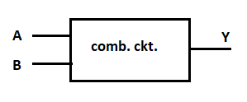
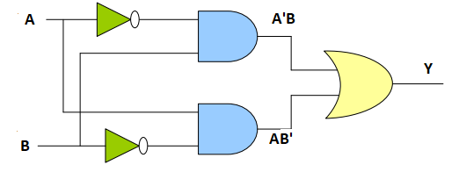
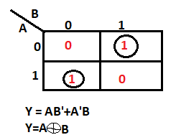
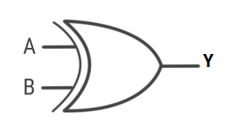
Prob: Design a combinational ckt with two i/ps that produes high output when gives odd 1's input.
1.Block Diagram
I/P |  | O/P
A | B | Y
0 | 0 | 0
0 | 1 | 1
1 | 0 | 1
1 | 1 | 0
5. Logic Diagram for Y=AB’+A’B
4.Logic Diagram
2.Truth Table
3.Boolean Function using K-map

Slide 8
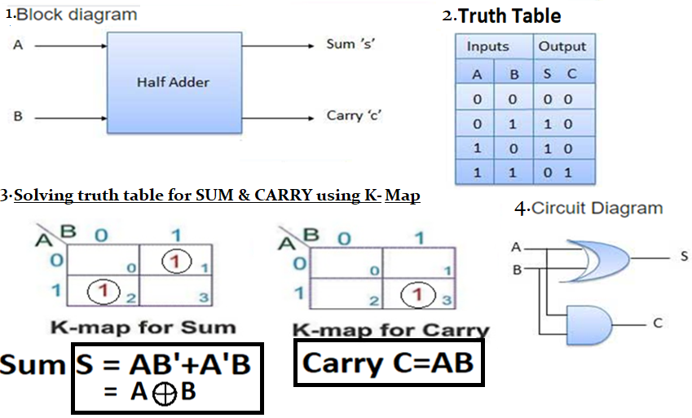
Half Adder
Half adder is a combinational logic circuit with two inputs and two outputs. The half adder circuit is designed to add two single bit binary number A and B. It is the basic building block for addition of two single bit numbers. This circuit has two outputs carry and sum.

Slide 9
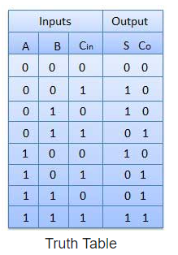
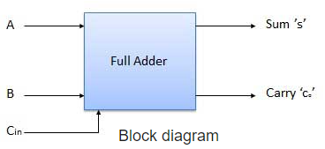
Full Adder
Full adder is developed to overcome the drawback of Half Adder circuit. It can add two one-bit numbers A and B, and carry c. The full adder is a three input and two output combinational circuit.
“A combinational circuit that perform the addition of three bits at a time is called Full-Adder.

Slide 10
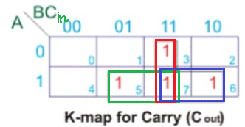
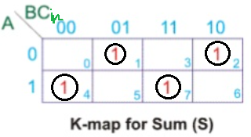
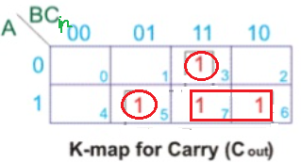
Solving truth table for SUM & CARRY using K-Map
C_{o} = BC_{in} + AC _{in} + AB This is the Boolean expression for CARRY.
Or K-map for CARRY can also be drawn as.
S = A’B’C_{in} + A’BC’_{in} + AB’C’_{in} + ABC_{in}
= A’B’C_{in} + ABC _{in} + A’BC’_{in} + AB’C’_{in}
=(A’B’+ AB)C _{in} + (A’B + AB’)C’_{in}
=(A ⊕ B)’C _{in} +(A ⊕ B) C’ _{in}
S = A ⊕ B ⊕C _{in}
This is the Boolean expression for SUM.
C_{o} = A’BC _{in} + AB’C _{in} + AB
= AB + C _{in} (A’B+ AB’ )
= AB + C _{in} (A ⊕ B)
This is the Boolean expression for CARRY.

Slide 11
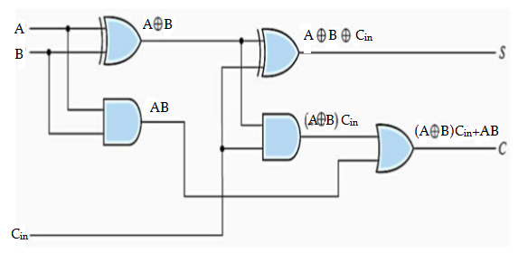
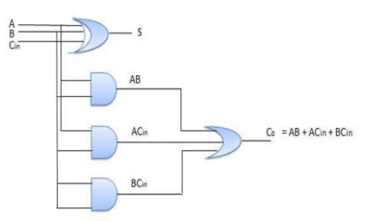
Logic Diagram
For:
Sum
S = A ⊕ B ⊕C _{in}
Carry
C = AB + C _{in} (A ⊕ B)
or
For:
Sum
S = A ⊕ B ⊕C _{in}
Carry
C = BC _{in} + AC _{in} + AB

